Slide 1
zomato
REVENUE & OPERATIONS
ANALYTICS
Presented by
Taniya
Restaurant Performance • Customer Insights • Delivery Operations
TOOLS
SQL • Python • Power BI • Excel
DATASETS
6 Tables • 800K+ Records
FOCUS
Revenue • Delivery • Cuisine Trends
Analyzing Zomato's restaurant, customer, menu, order, and delivery ecosystems to drive data-backed decisions
Notes:
This is the cover slide for the Zomato Market Intelligence Dashboard project. Introduce yourself, the project title, and briefly mention that this project analyzes Zomato's data ecosystem to uncover actionable business insights using SQL, Python, and Power BI.

Slide 2
Project Overview
Business Problem • Objectives • Expected Outcomes
BUSINESS PROBLEM
Zomato generates vast amounts of transactional, operational, and customer data across hundreds of cities. Without structured analysis, critical insights on revenue drivers, delivery efficiency, and customer preferences remain hidden — preventing strategic decision-making.
PROJECT OBJECTIVES
EXPECTED OUTCOMES
1
Analyze revenue performance across cities and time periods
💡 Actionable business insights from 800K+ records
2
Understand customer demographics, behavior, and ordering patterns
📊 Interactive multi-page Power BI dashboard
3
Evaluate restaurant distribution, cuisine trends, and ratings
🔍 City-wise & cuisine-wise performance report
4
Assess delivery operations: traffic, weather, and time efficiency
🚚 Delivery optimization recommendations
5
Build an interactive Power BI dashboard for stakeholder use
🎯 Data-driven marketing & expansion strategy
Zomato Market Intelligence Dashboard • Data Analytics Project
2 / 15
Notes:
Explain the business context: Zomato as a food delivery platform with rich data. The project tackles the challenge of making sense of large-scale restaurant and customer data. Walk through each objective and explain what outcome the stakeholder/recruiter should expect from this analysis.

Slide 3
Dataset Overview
6 Structured Tables • 800K+ Total Records • Relational Schema
TOTAL RECORDS ≈ 800K+
USERS
ORDERS
RESTAURANT
RECORDS
RECORDS
RECORDS
100,000
150,281
148,544
Key Columns: user_id, name, age, gender, occupation, income, education
Key Columns: order_date, sales_qty, sales_amount, currency, user_id, r_id
Key Columns: id, name, city, rating, cost, cuisine, address
FOOD
MENU
DELIVERY OPS
RECORDS
RECORDS
RECORDS
371,641
Linked
43,853
Key Columns: f_id, item, veg_or_non_veg
Key Columns: restaurant_id, food_id, price, portion_size
Key Columns: age, rating, weather, traffic, vehicle, time_taken
Zomato Market Intelligence Dashboard • Data Analytics Project
3 / 15
Notes:
Walk the audience through each of the 6 datasets. Mention the scale — over 800,000 total records. Emphasize that these tables are relational and connected through keys like user_id, r_id (restaurant_id), and f_id (food_id). This forms the foundation for all subsequent SQL and Python analysis.

Slide 4
Database Design & ER Diagram
Entity Relationships • Normalized Schema • Primary & Foreign Keys
WHY ER MODELING?
USERS
ORDERS
✦ Prevents data redundancy across large tables
user_id (PK)
order_id (PK)
name, age
user_id (FK)
✦ Enables efficient multi-table JOIN queries
occupation
r_id (FK)
✦ Maintains referential integrity across entities
amount
MENU
RESTAURANTS
✦ Supports scalable analytics and reporting
menu_id (PK)
id (PK)
r_id (FK)
name, city
KEY RELATIONSHIPS
f_id (FK)
rating, cuisine
→ Users → Orders (user_id)
price
→ Restaurants → Orders (r_id)
FOOD
DELIVERY
f_id (PK)
delivery_id
→ Restaurants → Menu (r_id)
item_name
weather, traffic
→ Food → Menu (f_id)
veg/non-veg
time_taken
→ Menu → Price & Portions
Zomato Market Intelligence Dashboard • Data Analytics Project
4 / 15
Notes:
Explain the ER model: Users place Orders. Restaurants fulfill Orders. Each Restaurant has a Menu which links to Food items. Delivery Operations track how those orders are fulfilled. The ER model helps enforce data integrity and enables complex joins across all tables for deeper analysis.

Slide 5
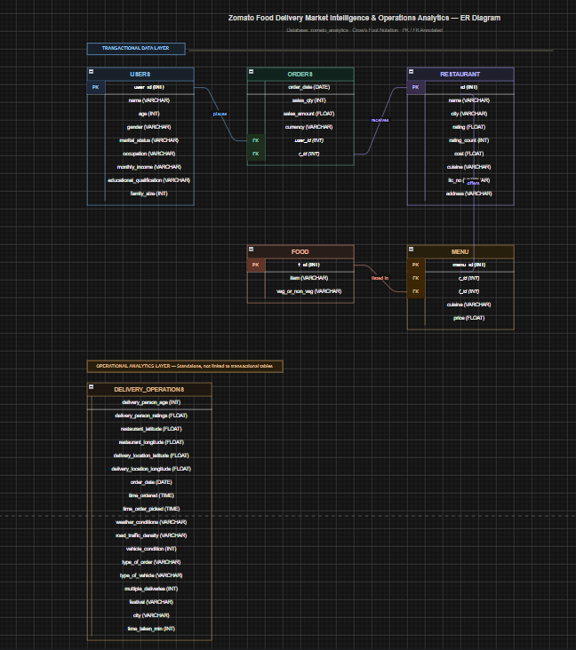
ER Diagram

Slide 6
Data Cleaning Process
Ensuring Data Quality Before Analysis
01
Duplicate Removal
Identified and dropped duplicate records using SQL DISTINCT and Python drop_duplicates() to ensure accurate aggregations.
02
Missing Value Handling
Replaced NULL entries with mean/median for numeric fields; flagged missing categorical values as 'Unknown' for restaurant ratings and menu data.
03
Data Type Corrections
Converted order_date to DATE type, sales_amount to FLOAT, and ensured rating fields were stored as numeric for comparison operations.
04
Menu Table Cleaning
Parsed nested JSON menu references, standardized cuisine categories, and resolved encoding issues in food item names.
05
SQL Optimization
Created indexed views and optimized JOIN conditions to improve query performance across 800K+ records during analysis.
Zomato Market Intelligence Dashboard • Data Analytics Project
5 / 15
Notes:
Data cleaning is a critical step before any analysis. Highlight that real-world data — especially from platforms like Zomato — is messy. Mention specific issues faced (e.g., Too Few Ratings in rating_count field, missing prices in menu) and how they were systematically resolved using both SQL and Python Pandas.

Slide 7
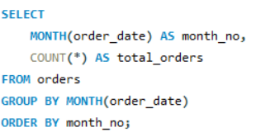
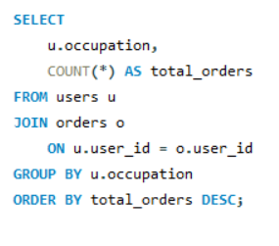
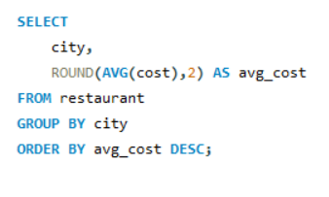
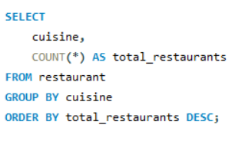
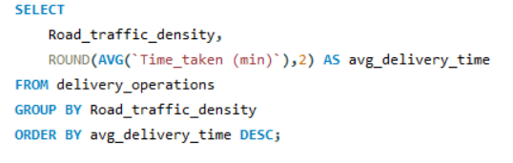
SQL Analysis
Core Business Queries Across 5 Analysis Dimensions
Revenue Analysis
Customer Analysis
Restaurant Analysis
Cuisine Analysis
Delivery Analysis
▸ Total revenue by month and city
▸ Customer demographics breakdown
▸ Top-rated restaurants per city
▸ Most popular cuisines by order volume
▸ Average delivery time by traffic density
▸ Average order value per customer
▸ High-value customer segmentation
▸ Restaurant count by city density
▸ Cuisine distribution across regions
▸ Weather impact on delivery duration
▸ Monthly revenue trend identification
▸ Order frequency per user
▸ Cost vs. rating correlation
▸ Veg vs. Non-veg preference
▸ Vehicle type performance
=
Zomato Market Intelligence Dashboard • Data Analytics Project
6 / 15
Notes:
Present the 5 core SQL analysis dimensions. Each type of query serves a business purpose: Revenue queries guide pricing strategy, Customer queries inform marketing, Restaurant queries support expansion planning, Cuisine queries enable targeted promotions, and Delivery queries help optimize operations.

Slide 8
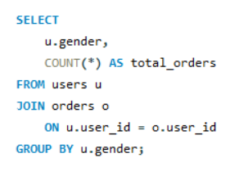
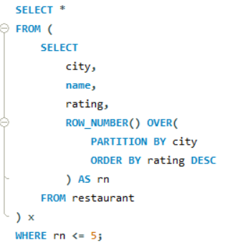
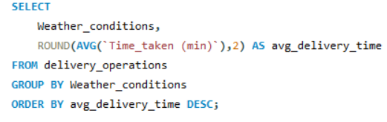
Advanced SQL Queries
Joins • Aggregations • Window Functions • Business KPIs
Multi-Table JOINs
BUSINESS KPIs GENERATED
Integrated customer, order, and restaurant data to generate cross-functional business insights.
💰
🛒
Total Revenue
Avg Order Value
👤
🏙️
Window Functions
Use ROW_NUMBER() and RANK() to identify top-performing restaurants within each city.
Customer LTV
Top City by Orders
⏱️
🍽️
Avg Delivery Time
Top Cuisine by Revenue
KPI Analytics & Aggregation
Generated business KPIs including Total Revenue, Avg Order Value, Customer Lifetime Value, and Delivery Efficiency Score.
⭐
🚦
Restaurant Rating Avg
Traffic Impact Score
7 / 15
Notes:
Advanced SQL skills are what differentiate a junior analyst from a mid-level one. Emphasize your use of window functions (RANK, ROW_NUMBER, LAG), multi-table JOINs, CTEs, and subqueries. Explain that each query was designed to answer a specific business question and feed into the final dashboard KPIs.

Slide 9
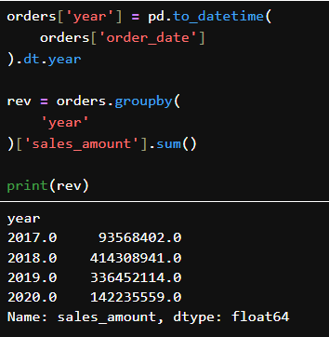
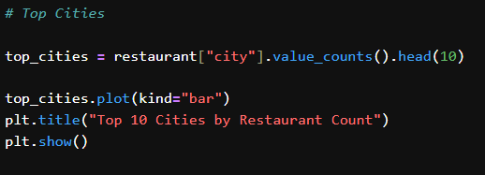
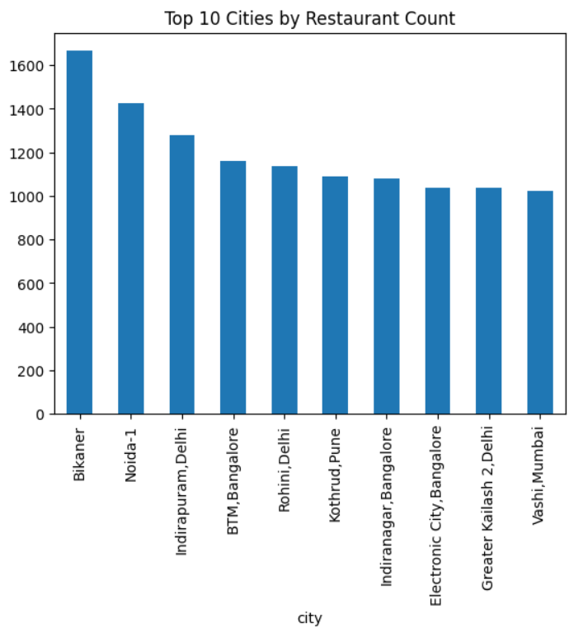
Python Analytics
Exploratory Data Analysis with Pandas & Matplotlib
users = pd.read_csv('clean_users.csv')
📈 Revenue Trend Analysis
Plotted year-over-year revenue (2017–2020) to identify peak periods and seasonal patterns in ordering behavior
🍽️ Cuisine Distribution
Bar charts and pie charts showing cuisine popularity across top cities to identify regional preferences.
Zomato Market Intelligence Dashboard • Data Analytics Project
8 / 15
Notes:
Python EDA bridges the gap between raw SQL outputs and the visual Power BI dashboard. Describe how Pandas was used for groupby, merge, and aggregation operations. Mention Matplotlib visualizations — revenue trend lines, traffic bar charts, cuisine pie charts — that informed the final dashboard design.

Slide 10
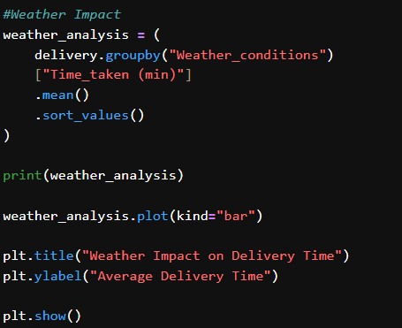
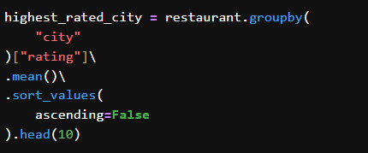
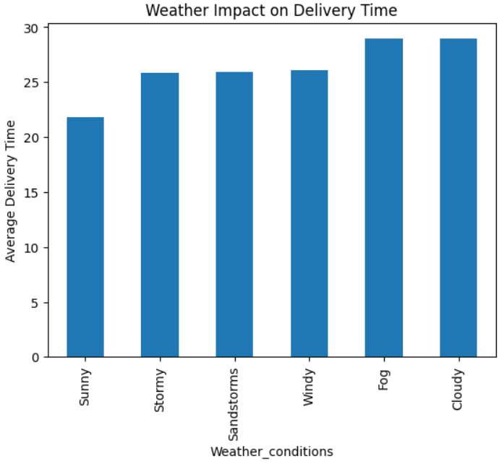
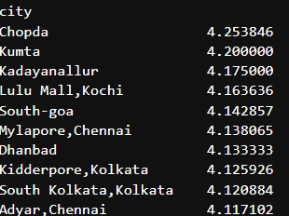
🚚 Delivery Performance
Analyzed average delivery time by traffic density and weather conditions using grouped statistics.
👥 Customer Insights
Demographic segmentation by age, income, occupation, and gender to profile Zomato's key customer segments.

Slide 11
Power BI Dashboard Development
End-to-End BI Workflow: Import → Model → DAX → Visualize
1
2
3
4
5
Data Import
Data Modeling
Relationships
DAX Measures
Dashboard Design
DAX MEASURES CREATED
INTERACTIVE FEATURES
Total Revenue
= SUM(orders[sales_amount])
⚡ City Slicer
Filter all visuals by selected city
Avg Order Value
= AVERAGE(orders[sales_amount])
⚡ Cuisine Filter
Drill down into specific cuisine types
Total Orders
= COUNTROWS(orders)
⚡ Weather Dropdown
Analyze impact by weather condition
Avg Delivery Time
= AVERAGE(delivery[Time_taken (min)])
⚡ Cross-filtering
Click any chart to filter related visuals
Avg Rating
= AVERAGE(restaurant[rating])
⚡ Drill-through
Navigate from summary to detail level
Zomato Market Intelligence Dashboard • Data Analytics Project
9 / 15
Notes:
Walk through the 5-step Power BI development process. Emphasize that DAX (Data Analysis Expressions) is a specialized formula language for Power BI — recruiters in analytics roles look for this. Explain that interactive slicers allow business users to self-serve insights without needing SQL knowledge.

Slide 12
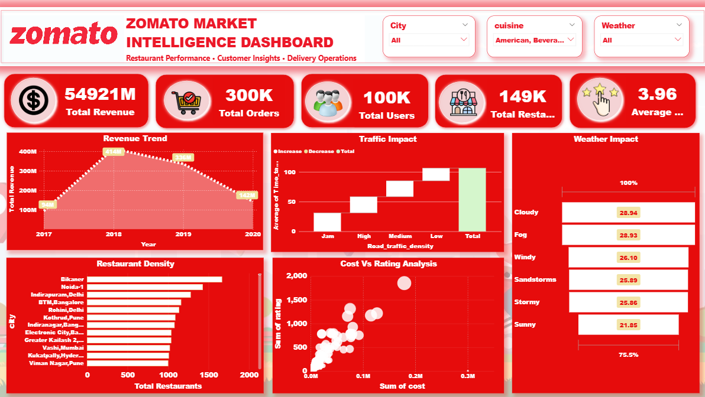
Dashboard Overview
Zomato Market Intelligence Dashboard — Power BI
Zomato Market Intelligence Dashboard • Data Analytics Project
10 / 15
Notes:
Present the live dashboard screenshot. Walk through the 5 KPI tiles at the top — Revenue, Orders, Users, Restaurants, Average Rating. Explain that these are dynamic cards powered by DAX measures and update automatically when filters are applied. Emphasize the Zomato branding and clean layout.

Slide 13
Key Visualizations
5 Core Charts Driving Business Intelligence
📈 Revenue Trend (2017–2020)
🚦 Traffic Impact on Delivery
Revenue peaked in 2018 then declined through 2020, suggesting pandemic-era impact on food delivery patterns.
Jam traffic conditions result in the highest average delivery time, nearly 2x compared to low-traffic routes.
🌦️ Weather Impact
🏙️ Restaurant Density
⭐ Cost vs Rating Analysis
Cloudy & Foggy conditions have highest avg delivery time (~29 min). Sunny conditions = fastest deliveries (~22 min).
Bikaner, Noida-1, and Indirapuram lead in restaurant count. Metro cities like Bangalore and Delhi show high market saturation.
Higher-cost restaurants generally trend toward higher ratings, though premium outliers exist with surprisingly low scores.
Zomato Market Intelligence Dashboard • Data Analytics Project
11 / 15
Notes:
Walk through each visualization and explain what story it tells. The revenue trend shows temporal patterns. Traffic impact is critical for delivery SLA management. Weather impact shows operational risk. Restaurant density informs market expansion strategy. Cost vs Rating shows the value-perception relationship across the platform.

Slide 14
Key Business Insights
Data-Driven Findings Across All Analysis Dimensions
01 City Dominance
02 Weather & Delivery
🏙️
🌦️
Bikaner, Noida-1, and Indirapuram lead in restaurant density. Metros like Bangalore and Delhi show market saturation, signaling opportunity in tier-2 cities.
Cloudy and Foggy conditions add ~7 minutes to average delivery time vs. Sunny conditions (~22 min). Weather is a significant operational risk factor.
03 Cost-Rating Correlation
04 Traffic & Performance
⭐
🚦
Higher-cost restaurants trend toward better ratings, but the relationship is not linear — value restaurants with great service can outperform premium ones.
Jam traffic density results in ~80% longer delivery time compared to low-traffic routes. Route optimization is critical for on-time delivery performance.
05 Regional Cuisine Trends
06 Revenue Peak (2018)
🍽️
📈
Cuisine preferences vary significantly by region. Local and regional cuisines dominate tier-2 cities while fast food and beverages lead in metro areas.
Revenue peaked in 2018 and declined through 2020. Year-over-year analysis reveals the need for customer retention programs to sustain growth trajectories.
Zomato Market Intelligence Dashboard • Data Analytics Project
12 / 15
Notes:
These 6 insights are the core deliverables of the entire project. Each insight is directly traceable back to SQL queries, Python analysis, or the Power BI dashboard. When presenting to recruiters, link each insight to a specific analysis technique — this shows you understand the full data analytics workflow.

Slide 15
Business Recommendations
Actionable Strategies Based on Data-Driven Insights
🌦️
Optimize Delivery in Adverse Weather
IMPACT: HIGH
Deploy dynamic surge pricing and pre-position delivery partners near high-demand zones during cloudy/foggy conditions to maintain delivery SLAs.
🏙️
Expand into High-Potential Cities
IMPACT: HIGH
Focus restaurant onboarding in tier-2 cities like Bikaner and Noida where restaurant density is high but delivery infrastructure is still developing.
⭐
Promote High-Rated Restaurants
IMPACT: MEDIUM
Feature top-rated restaurants prominently in app recommendations and targeted email campaigns to increase average order value and repeat orders.
🚦
Traffic-Aware Delivery Allocation
IMPACT: HIGH
Implement real-time traffic data integration to assign delivery orders to partners on low-congestion routes, reducing average delivery time by an estimated 20-30%.
🍽️
Cuisine-Targeted Marketing
IMPACT: MEDIUM
Use cuisine trend data to create geo-targeted promotions — push regional specialties in tier-2 cities and fast food combos in metro areas during peak hours.
Zomato Market Intelligence Dashboard • Data Analytics Project
13 / 15
Notes:
Business recommendations demonstrate your ability to translate data insights into strategy — a critical skill for any data analyst role. For each recommendation, link it back to the specific data finding that supports it. Mention that these recommendations were validated using the Power BI dashboard's interactive filters.

Slide 16
CONCLUSION
📋 Project Summary
zomato
Analyzed 800K+ records across 6 Zomato datasets using SQL, Python, and Power BI to deliver a comprehensive Market Intelligence Dashboard covering revenue, delivery, cuisine, and customer insights.
Market Intelligence
Dashboard
💼 Business Value
Delivered 6 key business insights and 5 actionable recommendations to optimize delivery operations, support restaurant expansion decisions, and drive targeted marketing strategies.
🎓 Learning Outcomes
SQL + Advanced SQL
Gained hands-on expertise in end-to-end analytics: data modeling, advanced SQL, Python EDA, DAX measures, and interactive dashboard design — all applied to real-world business scenarios.
Python (Pandas, Matplotlib)
🚀 Future Improvements
Power BI + DAX
Planned enhancements include machine learning for delivery time prediction, NLP-based customer review sentiment analysis, and real-time data refresh via Zomato API integration.
Excel (Data Prep)
Notes:
Conclude by summarizing the entire project in 4 key dimensions: What was done (Project Summary), What value it creates (Business Value), What you learned (Learning Outcomes), and What could be done next (Future Improvements). This shows a recruiter that you think like a product analyst, not just a data technician. Thank the audience and invite questions.

Slide 17
Thank You
By Taniya

